Slide 1
EGB1122 – PYTHON PROGRAMMING
END SEMESTER PROJECT REVIEW
Department of Electronics and Communication Engineering
Academic Year: 2024 – 2025 (Even Semester)
Register Number : 927624BEC049
Name : DINESH KUMAR.S
Year : I
Semester : II
Section : A
Date :11-06-2025

Slide 2
Title of the Project
Movie Ticket Booking System

Slide 3
Abstract
The system enables:
  Viewing currently available movies
  Selecting preferred showtimes
  Choosing seats and booking tickets
  Cancelling or modifying reservations
Designed using Python, the application utilizes functions, lists, dictionaries, and file handling to simulate a mini booking engine.
Aimed at providing a simple, user-friendly experience through the command line.

Slide 4
Abstract with CO/PO Mapping
Abstract | CO | POs | PSO
The system enables: Viewing currently available movies Selecting preferred showtimes Choosing seats and booking tickets Cancelling or modifying reservations Designed using Python, the application utilizes functions, lists, dictionaries, and file handling to simulate a mini booking engine. Aimed at providing a simple, user-friendly experience through the command line. | CO1 CO2 | PO9 PO10 PO11 PO12 | PSO1 PSO2

Slide 5
Introduction
The Movie Ticket Booking System is a console-based Python application that allows users to book movie tickets from a list of available shows.
It simplifies the process of selecting movies, viewing showtimes, and reserving seats.
The project mimics real-life booking platforms like BookMyShow, focusing on data handling, user interaction, and modular code design.

Slide 6
Python Programming - Concepts Used
Functions: To modularize actions like booking, canceling, and viewing.
Lists & Dictionaries: To store movie info, seating availability, and bookings.
Conditional Statements: Handle user inputs, validations, and flow control.
Loops: For menu navigation, booking iterations, and error checking.
File Handling: Optional use for storing booking records or show info persistently.
Exception Handling: To manage invalid inputs and errors gracefully.

Slide 7
Proposed Architecture
+---------------------+
| User Login/Register |
+---------+-----------+
|
v
+---------------------+
| Movie Selection |
+---------+-----------+
|
v
+---------------------+
| Show Timing & Seats |
+---------+-----------+
|
v
+---------------------+
| Booking Confirmation|
+---------+-----------+

Slide 8
Proposed Architecture - Description
User Interface Layer:
  Displays menu and captures user inputs.
Movie Manager Module:
  Manages list of available movies and showtimes.
Seat Manager Module:
  Handles seat availability, layout, and updates.
Booking Engine:
  Confirms reservations, cancels bookings, and generates tickets.
Storage Handler (optional):
  Saves ticket info to files for persistence.

Slide 9
List of Modules
main.py – The entry point for the application.
movies.py – Manages movies and showtimes.
booking.py – Core logic for seat selection and ticket confirmation.
seats.py – Manages seat layout and status updates.
user.py – (Optional) Handles user registration and login.
filehandler.py – (Optional) Saves booking records or prints ticket.

Slide 10
Description of Modules
main.py:
Displays the main menu and navigates to other modules.
movies.py:
Stores and displays movies, showtimes, and screens.
booking.py:
Takes user input for booking, checks seat availability, and confirms the booking.
seats.py:
Manages seat matrices (2D lists) for each show.
user.py (optional):
Registers users and stores login details.
filehandler.py (optional):
Generates ticket file or logs booking information.

Slide 11
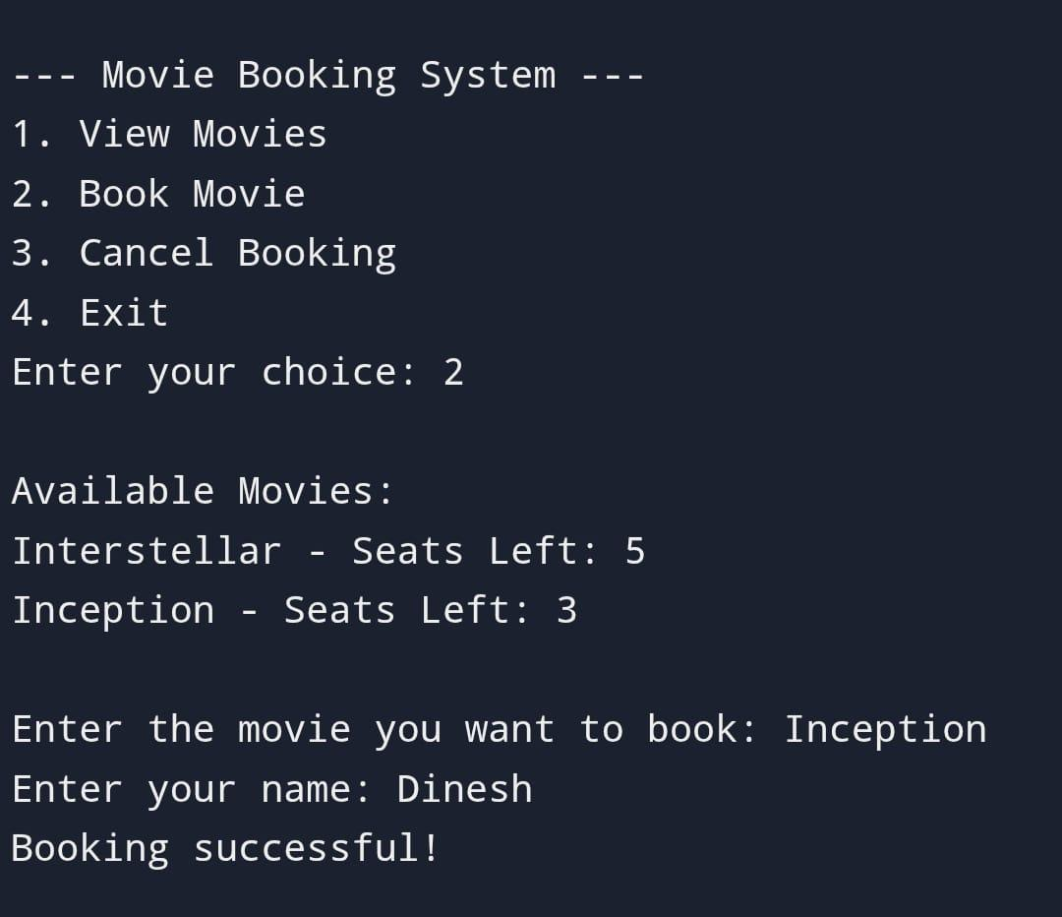
Results
A movie ticket booking system streamlines the process of reserving seats for movie screenings by allowing users to browse movies, view showtimes, select preferred seats, and make payments online or through an app. The system ensures real-time seat availability updates, prevents double bookings, and provides users with instant confirmation. It also benefits theater operators through efficient ticket sales tracking and reduced manual workload. Overall, the system enhances user convenience and operational efficiency, making the ticketing process faster, more accurate, and accessible.

Slide 12
Conclusion
In conclusion, the movie ticket booking system developed using Python provides a practical and user-friendly solution for automating the ticket reservation process. By leveraging Python's simplicity and powerful libraries, the system effectively handles tasks such as movie listings, seat selection, ticket booking, and payment simulation. It enhances the user experience by offering a seamless interface and reduces administrative workload through automated processes. Overall, the project demonstrates how Python can be used to build reliable and efficient applications for real-world scenarios like movie ticket booking.

Slide 13
Thank You
ANY QUERIES???

